Slide 1
COVID-19 VACCINE DIGITAL DISTRIBUTION PROPOSAL
PROJECT PPT BY : DEEPANSHU PATHAK
CLASS : MCA 9TH SEMESTER
ROLL NO : IC-2K16-15

Slide 2
INDEX
INTRODUCTION
Why do we need this ?
Project Structure
Working of Project
Why JSP Used for project ?
Limitations of project
Further Improvement
Conclusion

Slide 3
INTRODUCTION

Slide 4
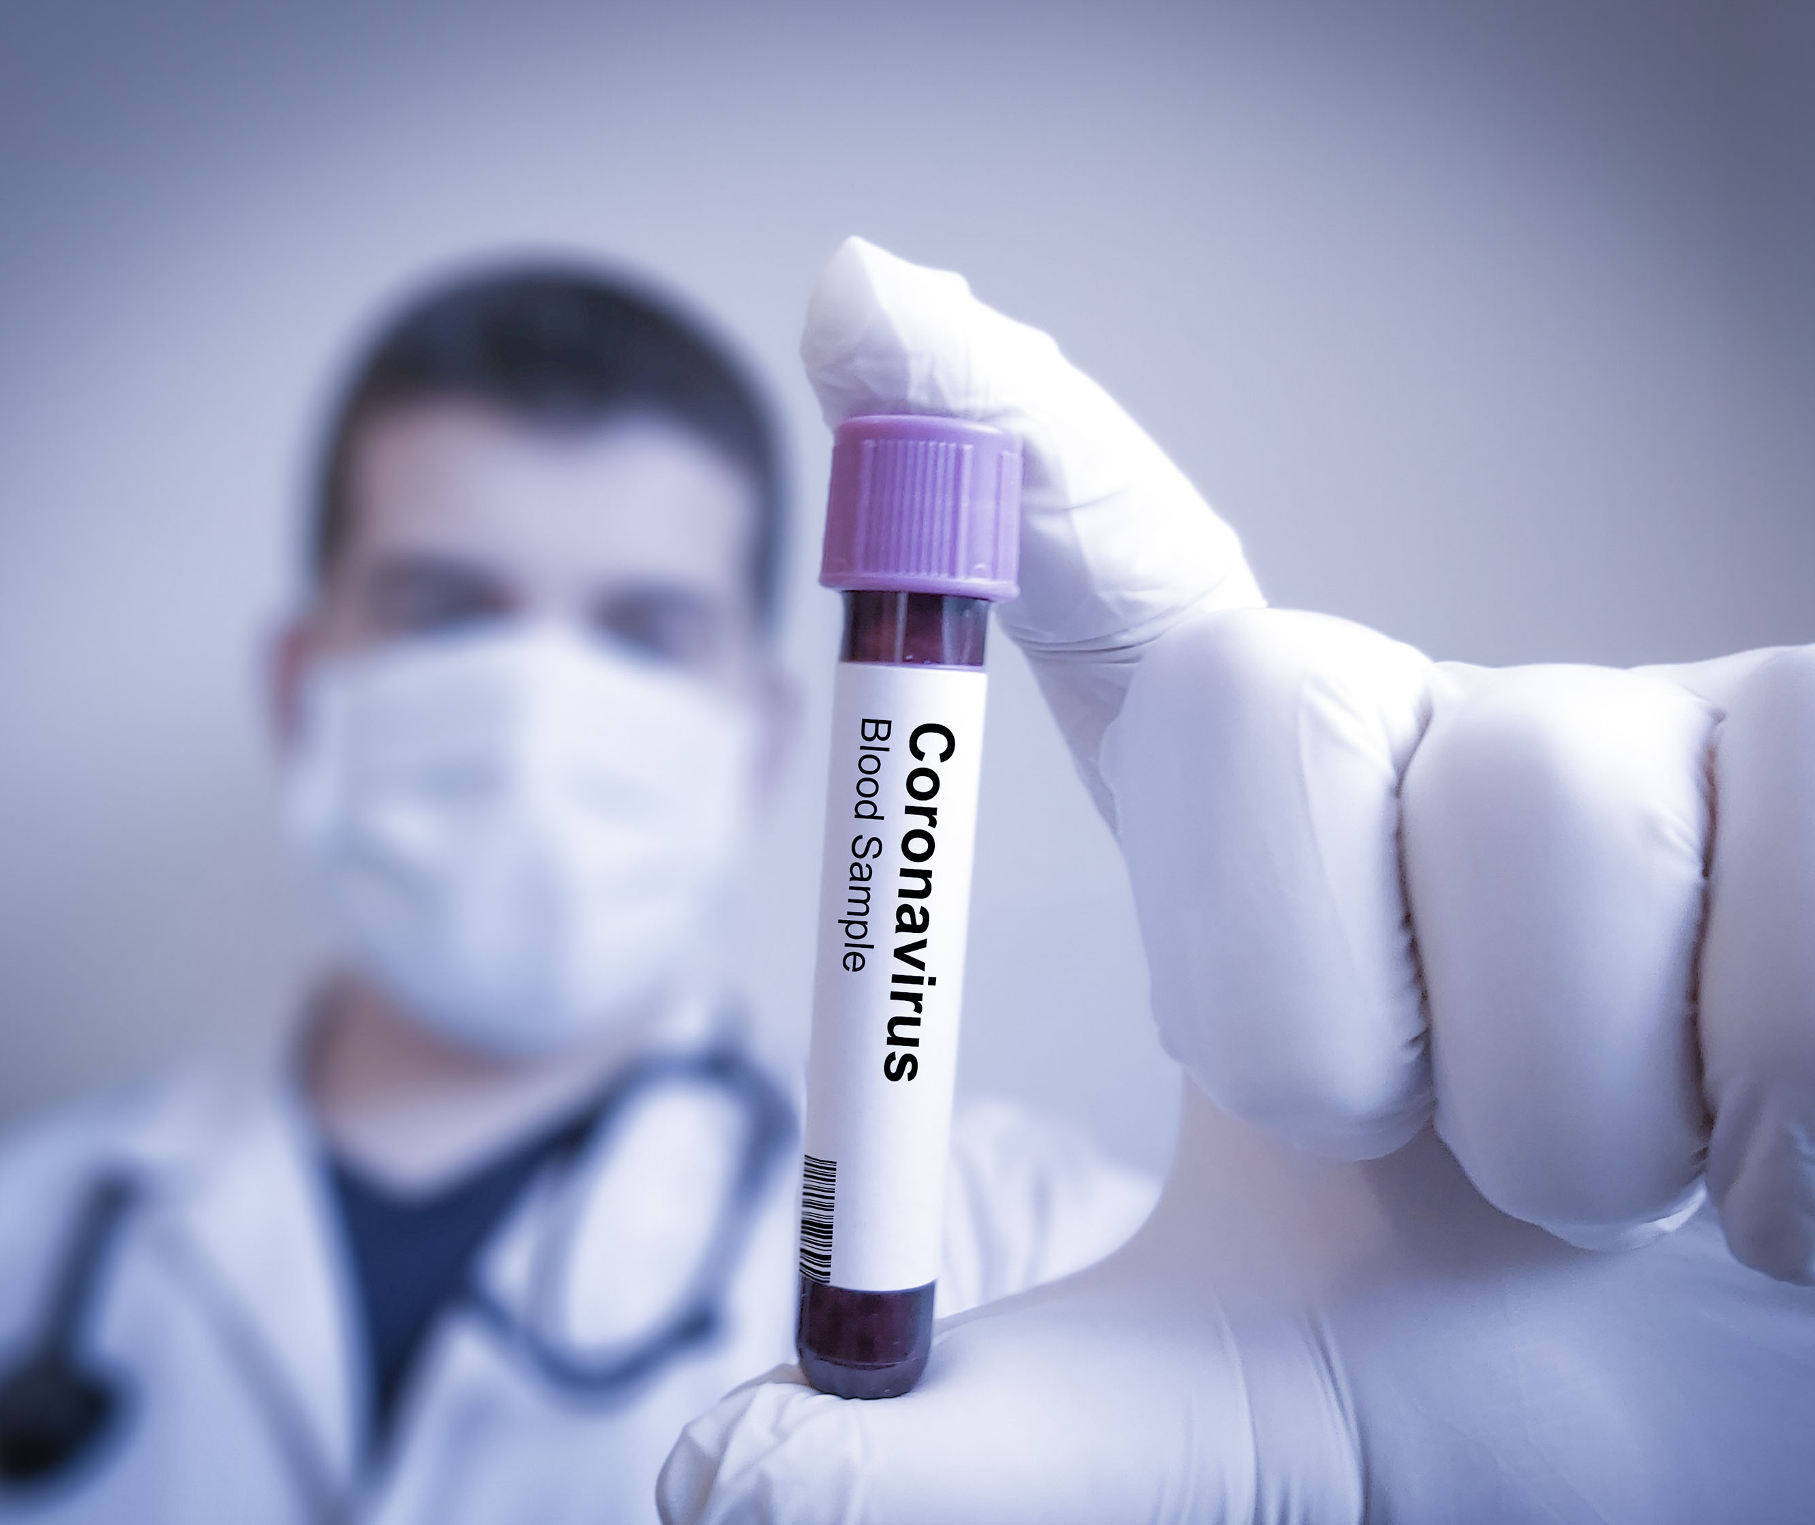
The Covid-19 pandemic in India is a part of worldwide pandemic of coronavirus disease 2019 . In March, after the lockdown was imposed, the United Nations (UN) and the World Health Organization (WHO) . praised India's response to the pandemic as 'comprehensive and robust', terming the lockdown restrictions as 'aggressive but vital' for containing the spread and building necessary healthcare infrastructure. India is among one of countries which had been severely hit by this deadly virus .

Slide 5
WHY DO WE NEED THIS PROJECT ?
Ten months into the Covid-19 pandemic ,the expert group on Corona virus vaccine is formulating strategies to plan out the distribution of the vaccine in the country . Government is planning strategies on how to distribute vaccines to fellow citizens once it's ready .India is already working on putting a well-established vaccine delivery system in place. This digitized network along with digital health IDs will be used to ensure immunization of our citizens,” said our Honorable Prime Minister Narendra Modi .

Slide 6
Why do we need this ?? (cont..)
So as our country is moving towards digitization ,I have come up with a proposal on how we can manage the distribution of vaccine through digital platform .Till now the Electronic Vaccine Intelligence Network (eVIN) is being used by the State/UT governments in India to monitor the supply chain of Covid response material.
Now as real-time information on vaccine stocks and storage information about all chain points in different states are provided to us by the eVIN , I aim to create a system that can use this information and help the government in making a similar digital system that can help with proper distribution of vaccine across the country .

Slide 7
PROJECT STRUCTURE
I had divided my project in to 4 users:
1) Admin
2) State Government
3) City Administration
4) Hospital

Slide 8
PROJECT STRUCTURE(CONTD..)
Admin => The Admin user will have right to add/modify the vaccine details and its storage details .He/She will be authorized to add all the states their respective cities and ward into the system . Admin will be authorized to supply the vaccine to all the states according to the formula decided .
State =>The state user will be responsible for sending the vaccine that it has received from the Admin user and will be authorized to distribute these vaccines to its particular cities .

Slide 9
PROJECT STRUCTURE(CONTD..)
3. City =>The City user will receive the vaccines distributed by the state user and will be authorized to supply these vaccines to the respective hospitals of its city .
4. Hospital/Ward => For smooth supply chain we will divide the city into number of wards and each ward will have a particular hospital where all the people of that particular ward will be vaccinated . So this ward user will receive the vaccine distributed by the city user and will supply it to the people . He/She will be able to view the list of user who are vaccinated and who are not vaccinated .He will be authorized to send mail to non vaccinated people to ask them to come for vaccination .

Slide 10
WORKING OF PROJECT

Slide 11
WORKING OF PROJECT(CONTD..)
The working of this system will start with processing the information provided by the Ministry of Health and Family Welfare about the number of active cases of coronavirus . From there we will also get the State wise data of coronavirus patients .Than the data will be taken from the eVIN regarding the number of vaccine available .
Now once we have all the data regarding the number of patients and vaccine available ,my proposed system will process that information and carry out the calculations that how these vaccines should be distributed in a way that every state would get the amount of vaccine which is proportional to the number of cases in it .

Slide 12
WORKING OF PROJECT(CONTD..)
Now my system will work in a way that the vaccine would be made available to the patients and than to the corona warriors of our country like the doctors ,nurses ,medical staff ,police etc .
And to avoid delay of delivery of vaccine to the normal people ,my proposed system will take measures that some portion of total percentage of vaccine is also made available to normal citizens simultaneously along with the corona patients and corona warriors .

Slide 13
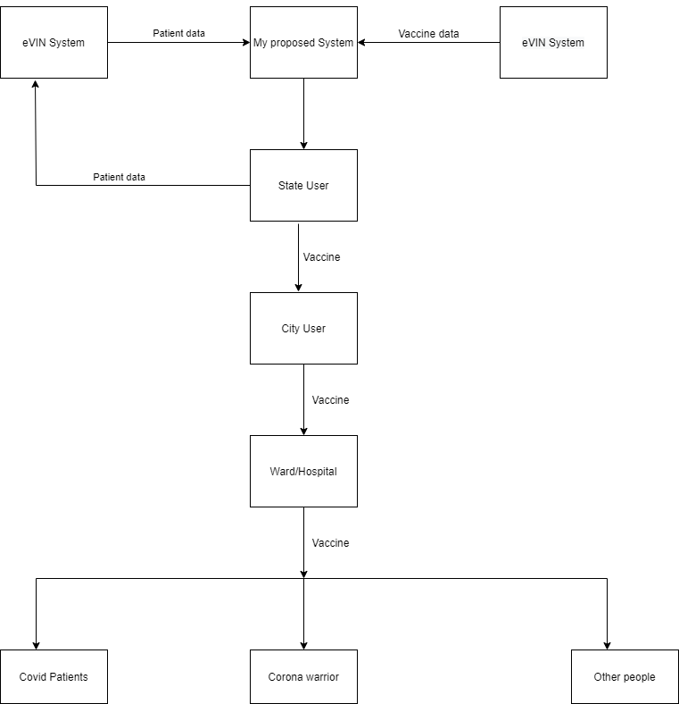

Slide 14
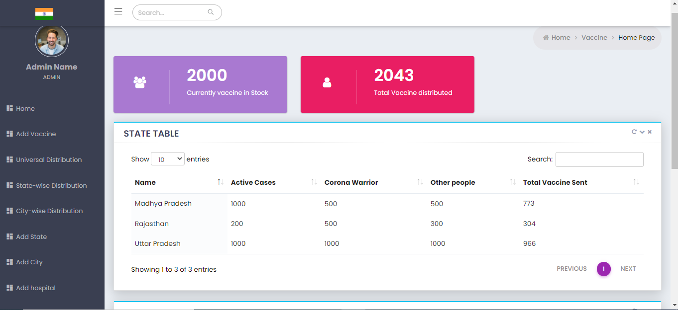
ADMIN PAGE
Text

Slide 15
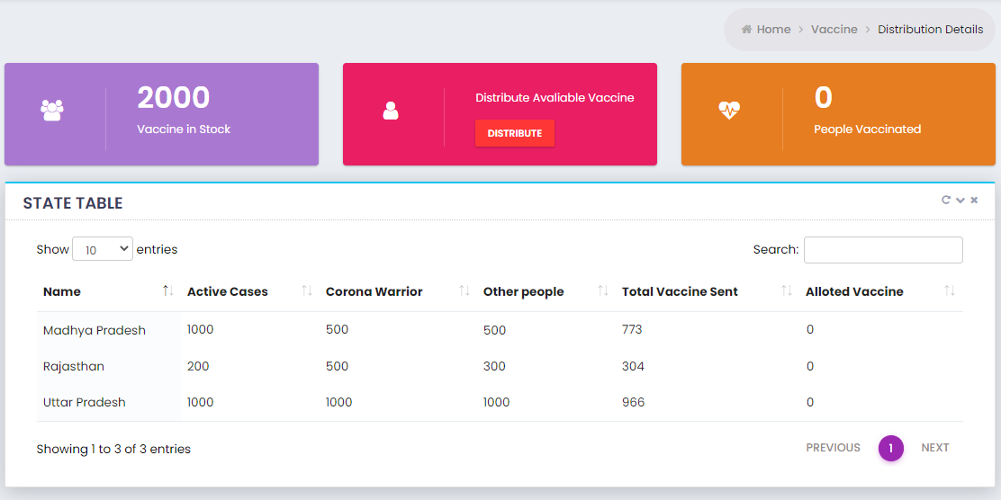
State Distribution

Slide 16
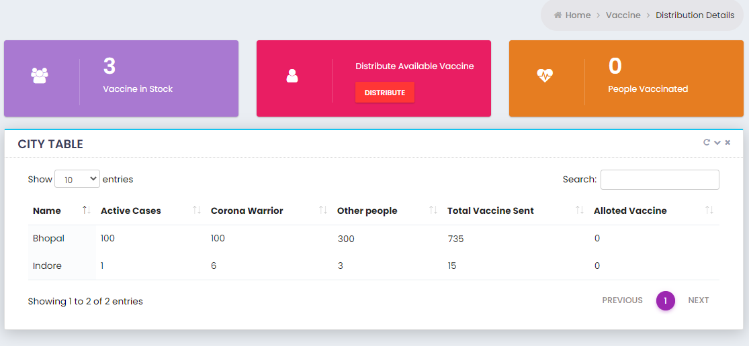
City wise distribution

Slide 17
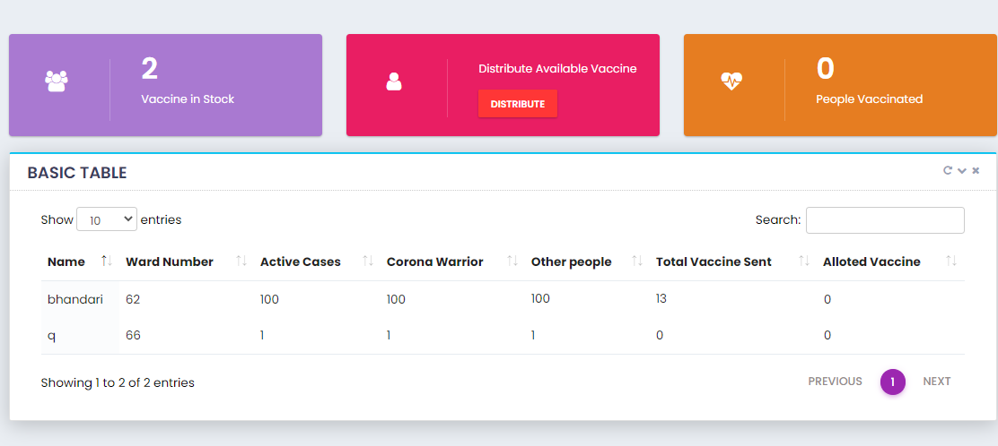
Hospital distribution

Slide 18
WHY USE JSP FOR THIS PROJECT ??
One of the main reason of using JSP in my system is that ,JSP has access to all the major Java API's including JDBC.
JSP tags allows us to write Java code inside static HTML web pages .
It is more convenient to write regular HTML than to have println statements that generate HTML which is done in Servelets .
It is comparatively faster as it has access to all the Java API'S so there is no need of using any external API which might slow down the processing of system .

Slide 19
LIMITATIONS OF MY PROJECT !!
The system will have to rely of the information provided by Ministry of Health and Family Welfare for knowing the number of coronavirus cases in the country .
The system will get the information regarding the availability of vaccine from Goverment only through eVIN .

Slide 20
FURTHER IMPROVEMENTS
My proposed system can easily be modified with simple changes in way that it can also help in tracking of vaccine for a particular person and he/she can track his/her vaccine .
As the number of people to be vaccinated in India is more ,it will require more infrastructure to easily handle such amount of people ,so we can keep a track of such places state wise in my system which will help the people to easily locate their vaccination centers . And google maps can be integrated for the citizens ease .
SMS api can also be integrated so that citizens can be given the information regarding the date and place where he will be vaccinated through an SMS .

Slide 21
CONCLUSION
The expert group on Corona virus vaccine is formulating strategies to plan out the distribution of the vaccine in the country .So as our country is moving towards digitization ,this project system of mine is a small suggestion that how Vaccine distribution in our country can be managed efficiently using my system.

Slide 22
THANK YOU!!

